Slide 1
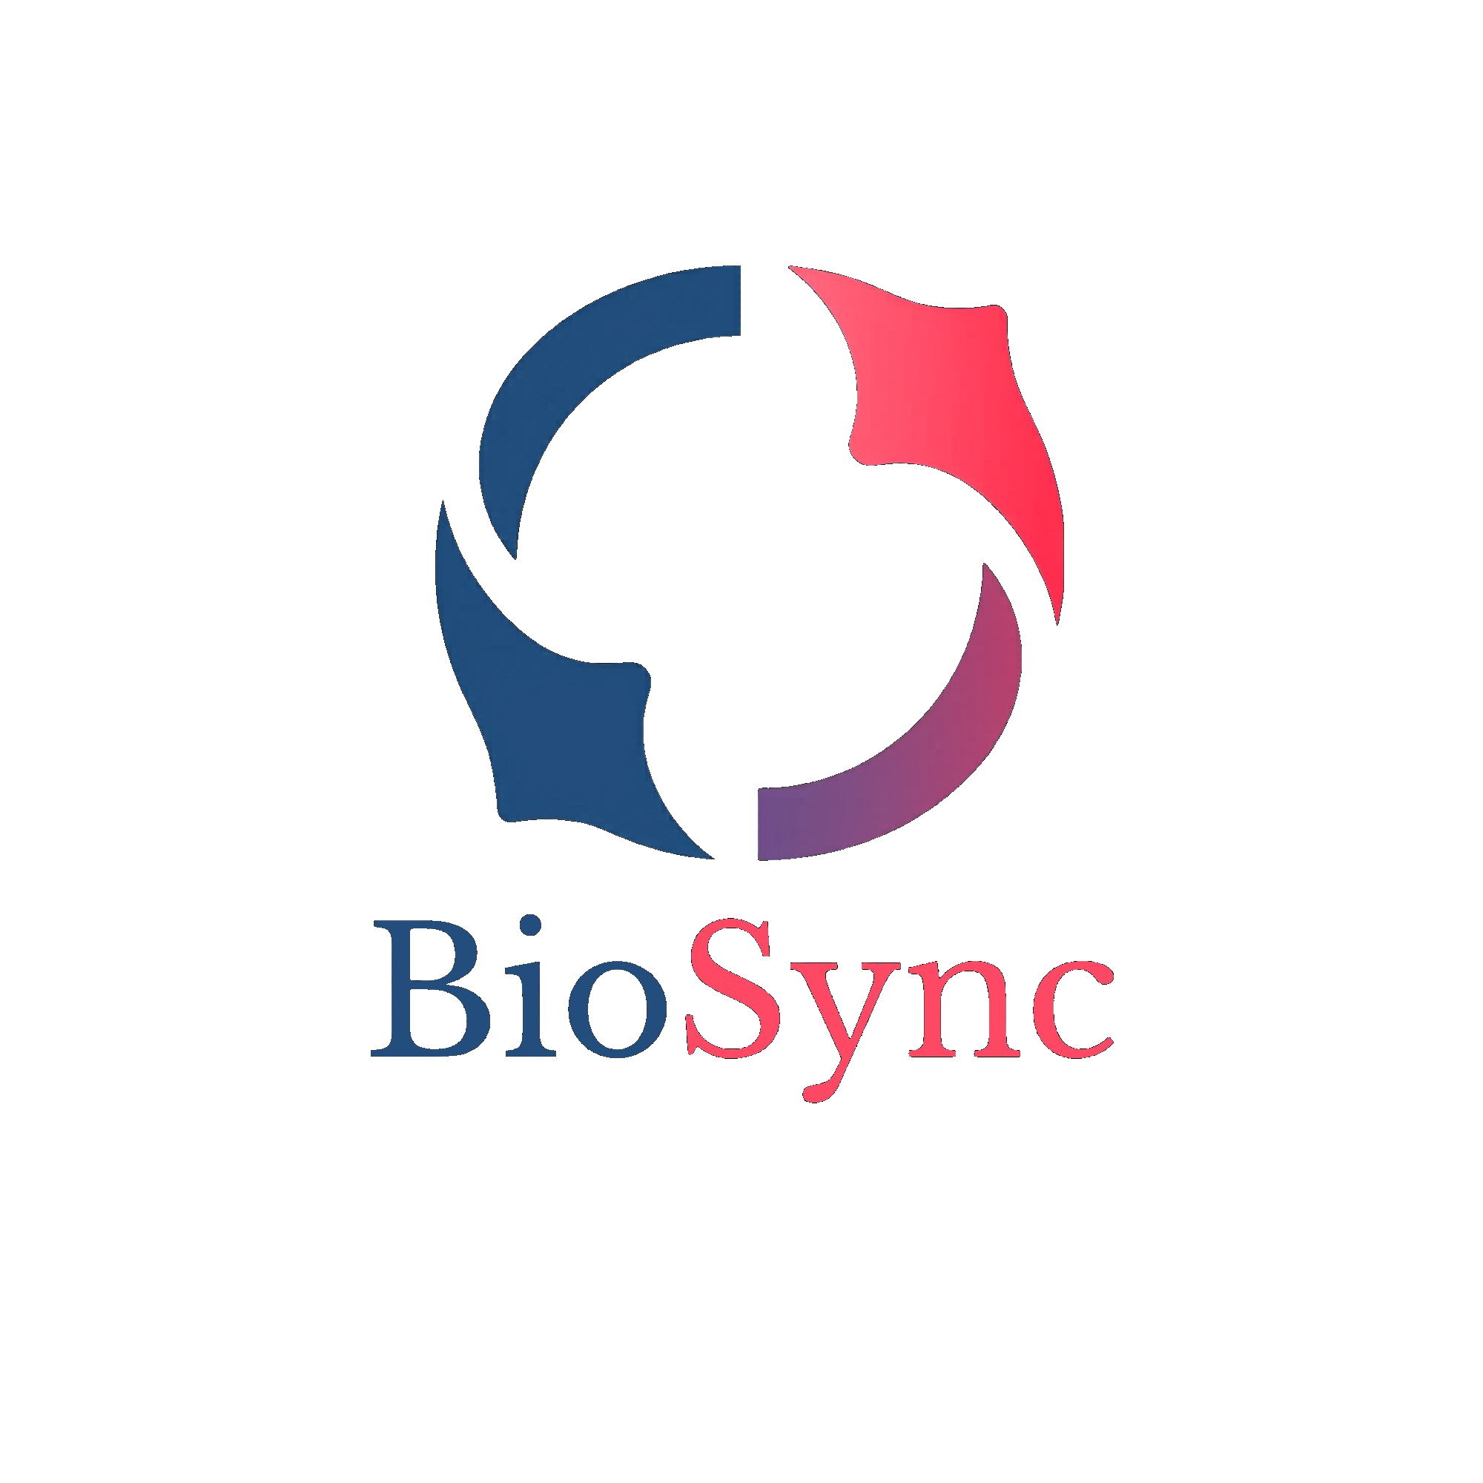

STARTING SOON
Your Health. All in One Place.
Sarah Ayres
Led full-stack development across all major features — dashboard, caregiver portal, PDF extraction, notification system, clinical thresholds, and UI design.
Joshua Eckman
Developer Built the initial Flask application structure and SQLite database schema. Implemented age/sex-based heart rate thresholds using CDC resting BPM ranges. Contributed to presentation materials.
Toni Wilson
Developer helped build front-end and back-end development. Contributed to application workflow, product usability and presentation materials.
Myra Williams
Built the live biometric readings feature allowing users to log real-time vitals directly from connected devices.
CSC 289 — Programming Capstone | Spring 2026 | FTCC | Group 2

Slide 2
The Problem
Health data is fragmented across dozens of apps, devices, and paper records.
Scattered Data
No Clinical Context
Caregiver Gap
Patients juggle separate apps for heart rate, blood pressure, glucose, and more — no single source of truth.
Raw numbers mean nothing without clinical thresholds. Most apps just log data — they don't tell you if something is wrong.
Doctors and family caregivers have no visibility into patient health between visits unless the patient manually shares it.

Slide 3
What is BioSync?
One secure workspace for biometric tracking, clinical document storage, health alerts, and caregiver access.
👤 Patients
🩺 Caregivers
📋 Health-Conscious
Log readings, upload lab reports, view trends, and receive alerts when readings fall outside safe clinical ranges.
Monitor linked patients from a dedicated portal. Receive alerts when a patient has a critical reading.
Track wellness goals, monitor multiple metrics over time, and share data with their care team.

Slide 4
Meet Our Users
Joy Edwards
Jason Spencer
Micah Davis
The Student
The Caregiver
The Patient
Busy grad student juggling fitness trackers and health apps. Wants one place to see her full health picture without switching between five apps.
Home health nurse managing elderly patients between visits. Needs remote visibility into patient vitals and instant alerts when something is wrong.
Managing a chronic illness across multiple specialists. Needs an app that tracks all his metrics and makes it easy to share records at appointments.

Slide 5
Key Features
📊 Biometric Dashboard
📄 PDF Document Upload
🔔 Smart Notifications
6 live metric cards — Heart Rate, Blood Pressure, SpO2, Glucose, Temperature, and Weight — each with clinical status badges.
Upload clinical lab reports and BioSync automatically extracts biometric readings using pattern recognition.
Every reading is checked against clinical thresholds. Patients and caregivers get instant alerts for anything that needs attention.
📈 Trends & Charts
🤝 Caregiver Portal
📥 CSV Export
Interactive Chart.js visualizations with time range filters. Blood pressure shows as a dual-line systolic/diastolic chart.
Full separate dashboard for caregivers. Link to patients via unique codes. View patient biometrics and receive patient-specific alerts.
Download biometric data per metric or as a monthly all-readings report to share with doctors.

Slide 6
How It Works
1
2
3
4
5
Register
Add Data
Extract
Alert
Monitor
Patient or caregiver creates an account with full health profile
Upload clinical PDFs or log readings manually from any device
BioSync extracts biometrics and applies clinical thresholds automatically
Notifications fire instantly for readings outside safe ranges
Patients view trends. Caregivers monitor all linked patients from one hub.

Slide 7
Clinical Threshold Intelligence
Every reading is evaluated against evidence-based clinical guidelines — not arbitrary numbers.
Metric | Normal | Caution | Warning | Emergency
Heart Rate | 60–100 BPM | >100 Tachycardia | >150 BPM | <40 or >150 BPM
Blood Pressure | <120/80 | Elevated / Stage 1 | Stage 2 (≥140/90) | Crisis (>180/120)
SpO2 | ≥95% | 91–94% Concerning | 80–89% Seek Care | <80% Cyanosis
Glucose | 70–108 mg/dL | 120–180 Borderline | >180 High | <50 or >315
Temperature | 95–99.1°F | 99.3–100.4 Slight Fever | 100.6–102.2 Fever | >102.4 High Fever
Heart rate thresholds are personalized using age and sex from CDC resting heart rate ranges.

Slide 8
Security & Privacy
🔐 Password Security
🛡️ Session Security
All passwords hashed with PBKDF2-SHA256 + salt. Plain text passwords are never stored or logged.
Sessions signed with Flask's SECRET_KEY. Only user_id is stored in the session cookie — nothing sensitive.
🔒 Access Control
📋 HIPAA Alignment
login_required and caregiver_required decorators enforce route-level auth. Caregivers can only see patients they are explicitly linked to.
Minimum necessary access, audit trails via notification logs, role-based data access, and explicit patient consent via patient code linking.
🔗 Patient Consent
📁 Data Ownership
Caregivers cannot access any patient data without the patient generating and sharing a unique code — the patient controls the link.
Patient documents and readings are stored server-side and never shared with third parties. No ads. No data selling.

Slide 9
What's Next
📱 Mobile App
⌚ Device Integration
🔑 Password Reset
React Native app that connects directly to wearable devices via Bluetooth. Sync with Apple Health, Google Health Connect, and Samsung Health.
Direct Bluetooth connectivity to COLMI R02 smart ring and Wellue pulse oximeter — readings flow straight into BioSync without manual entry.
Email-based password recovery so users can regain access without admin intervention.
⚙️ Settings Page
☁️ Cloud Deployment
Profile editing, notification preferences, and account management all in one place.
Deploy to Render with PostgreSQL for production. QR code access for live demos and real-world use.

Slide 10
Live Demo
Let's see BioSync in action.

